Slide 1

Artificial Intelligence Lecture 08 – Reinforcement Learning
Dr. Rajiv Misra, Professor
Dept. of Computer Science & Engg.
Indian Institute of Technology, Patna
rajivm@iitp.ac.in

Slide 2
Contents
Dynamic Adaptive Programming (ADP)
Temporal Difference (TD) Learning
Q-Learning
SARSA

Slide 3
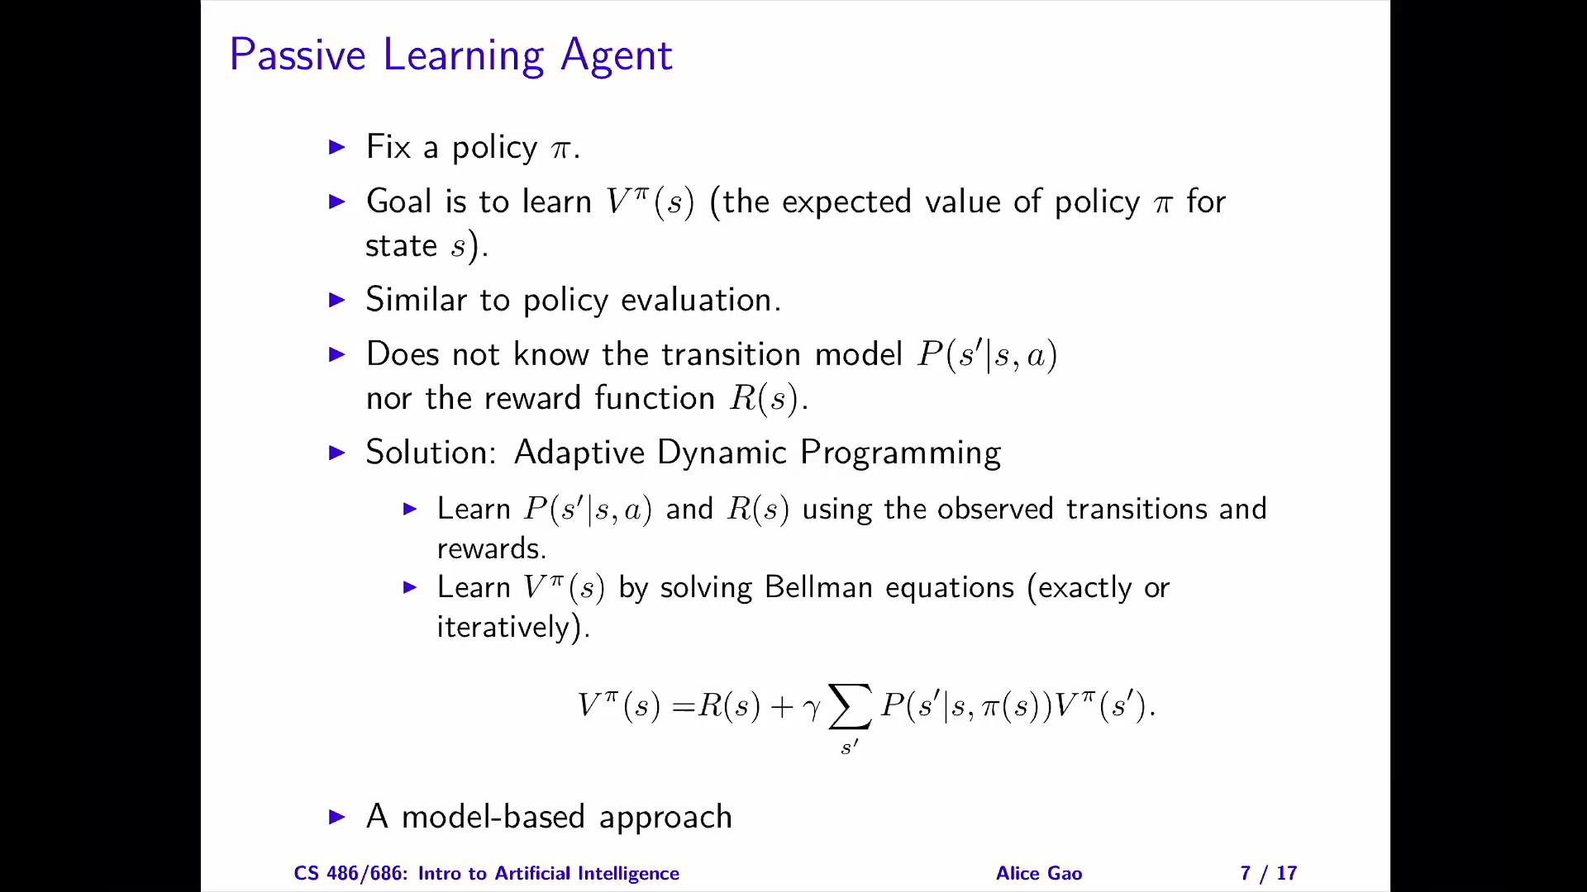

Slide 4
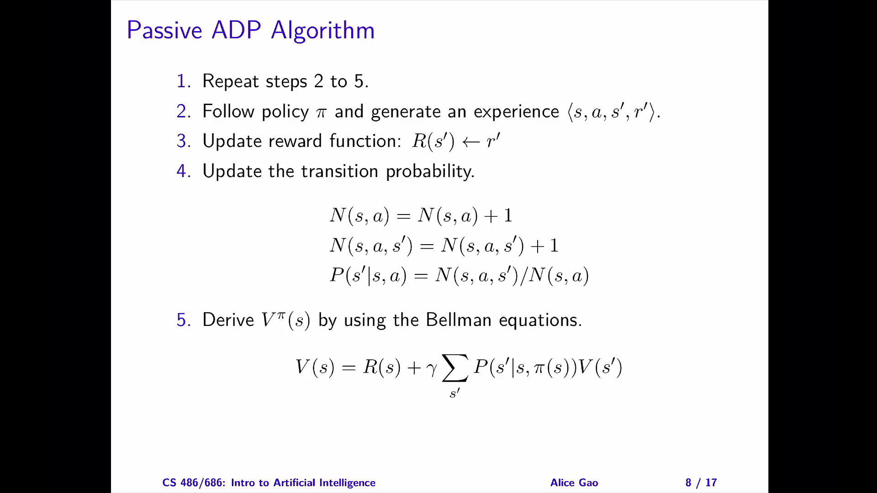

Slide 5
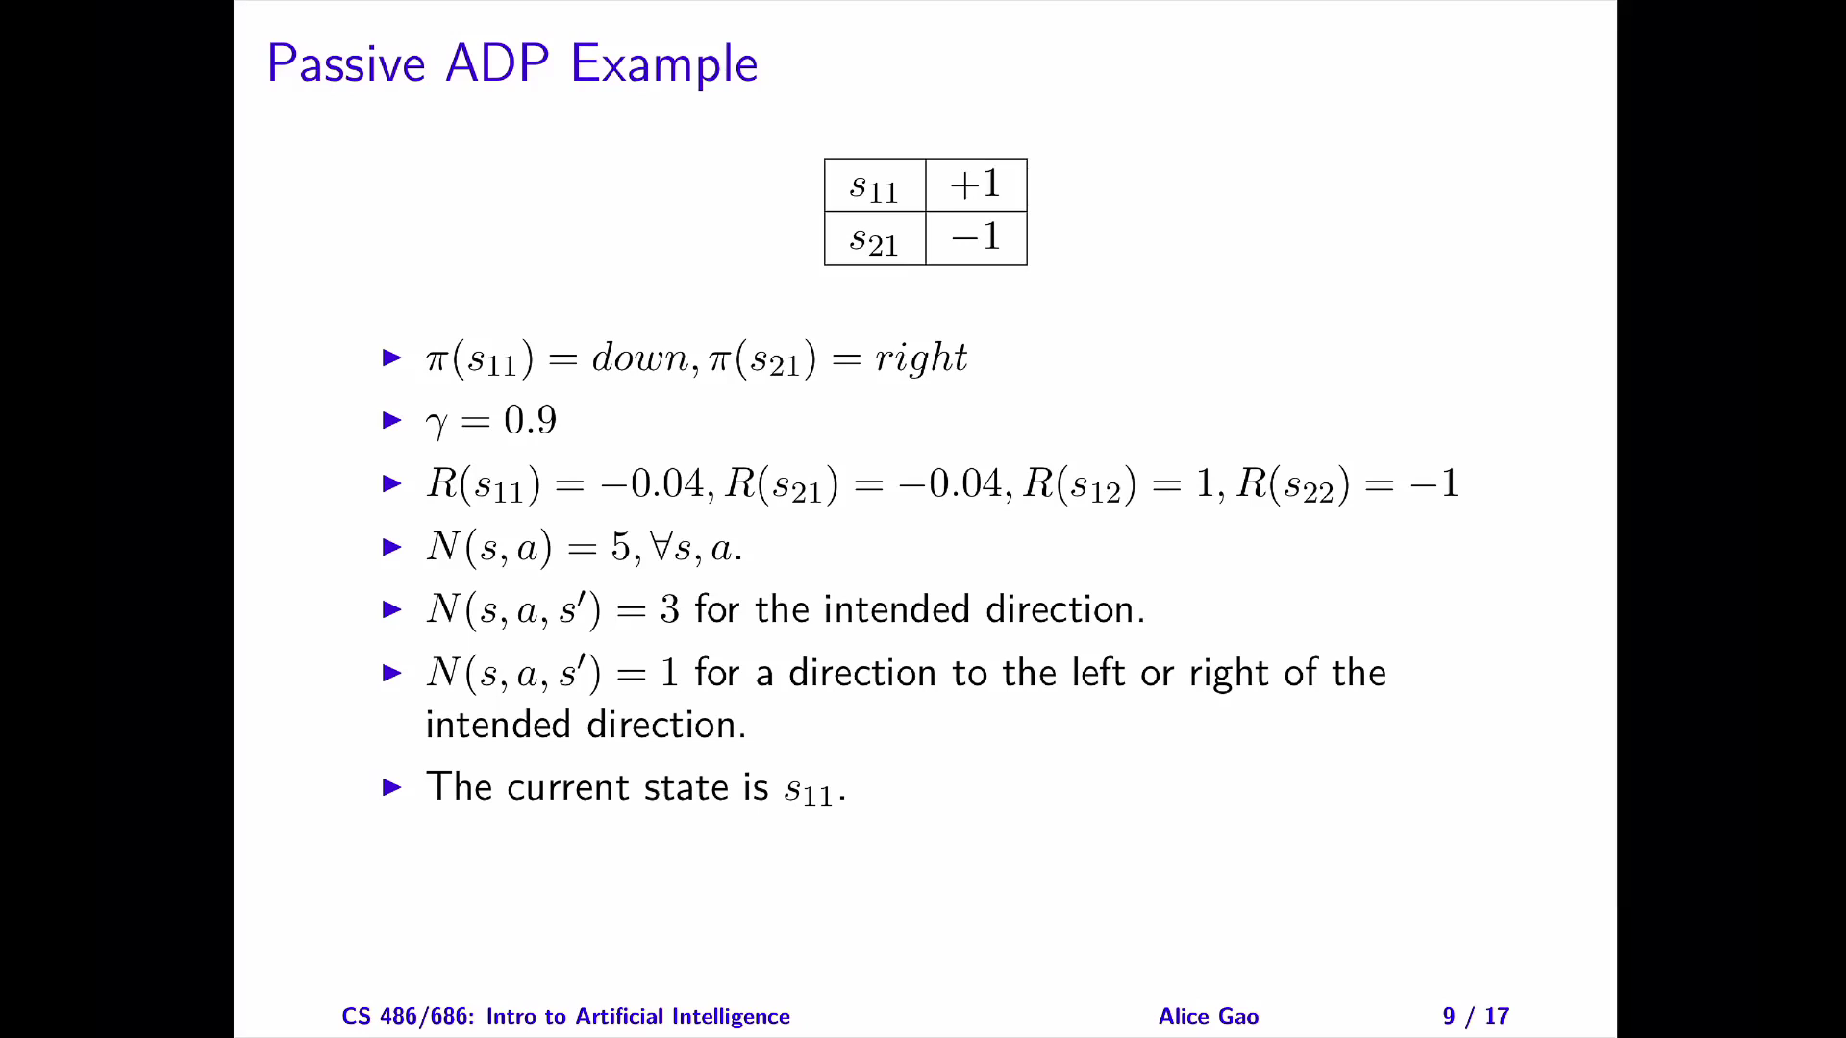

Slide 6
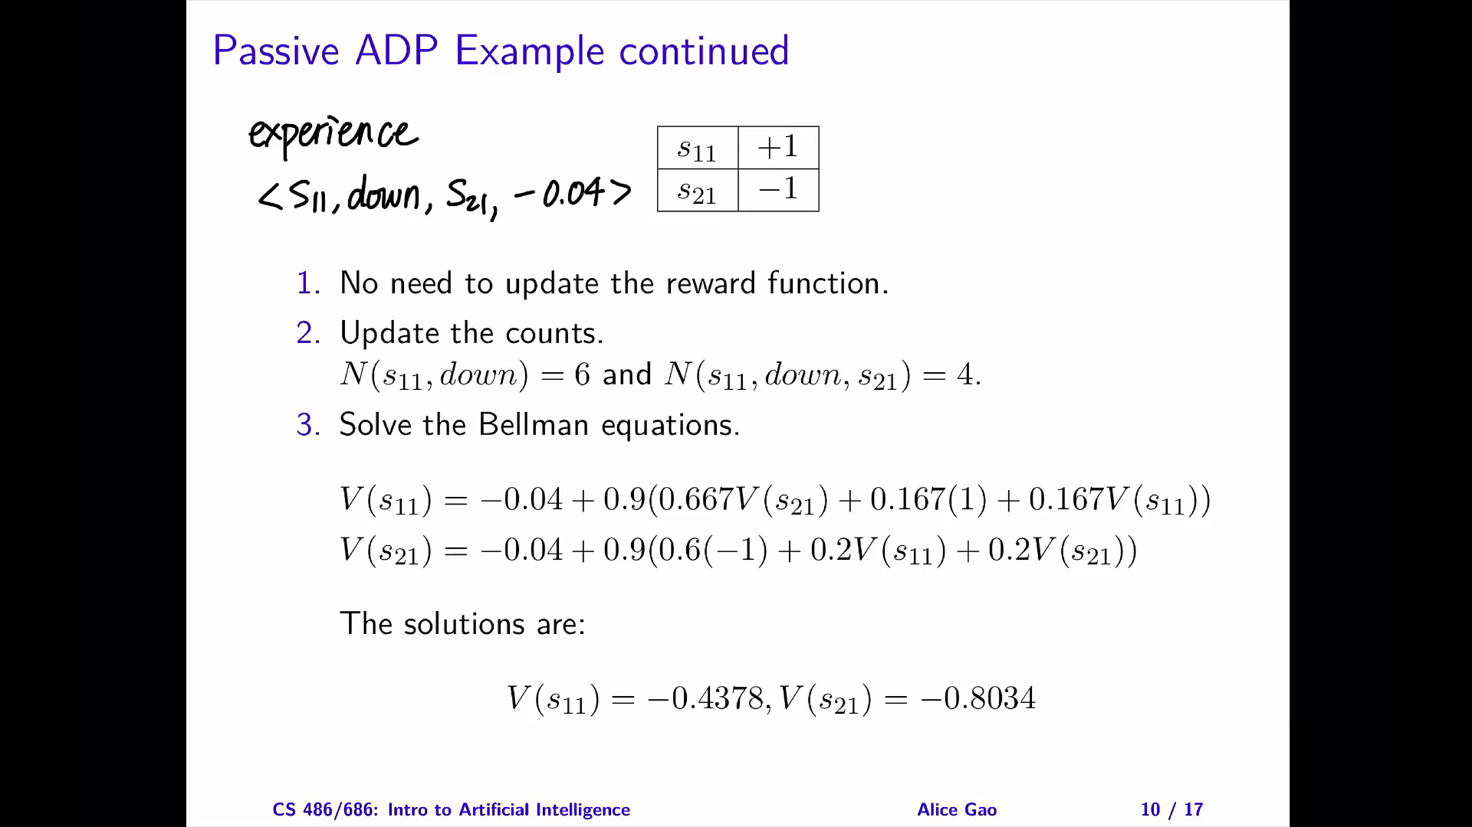

Slide 7
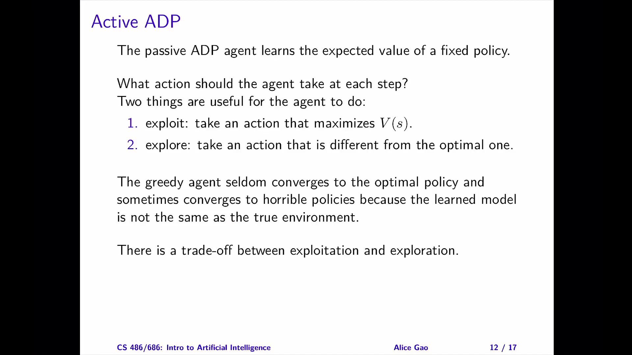

Slide 8
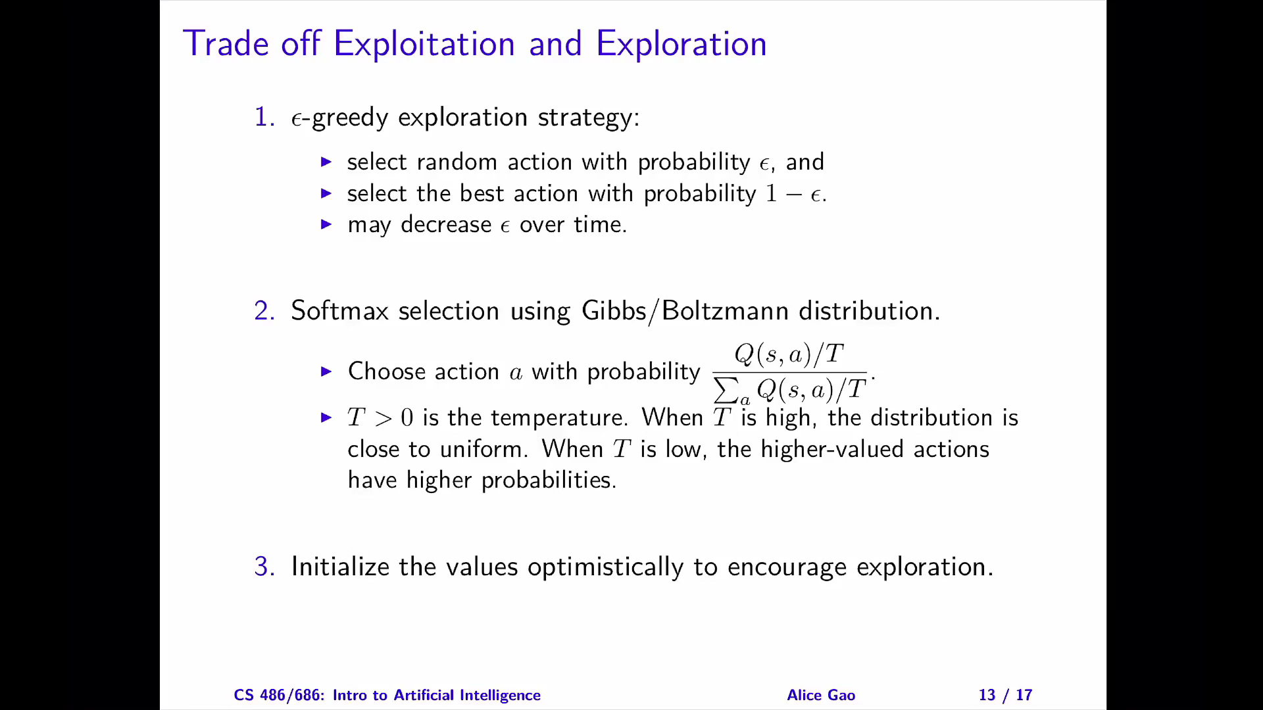

Slide 9
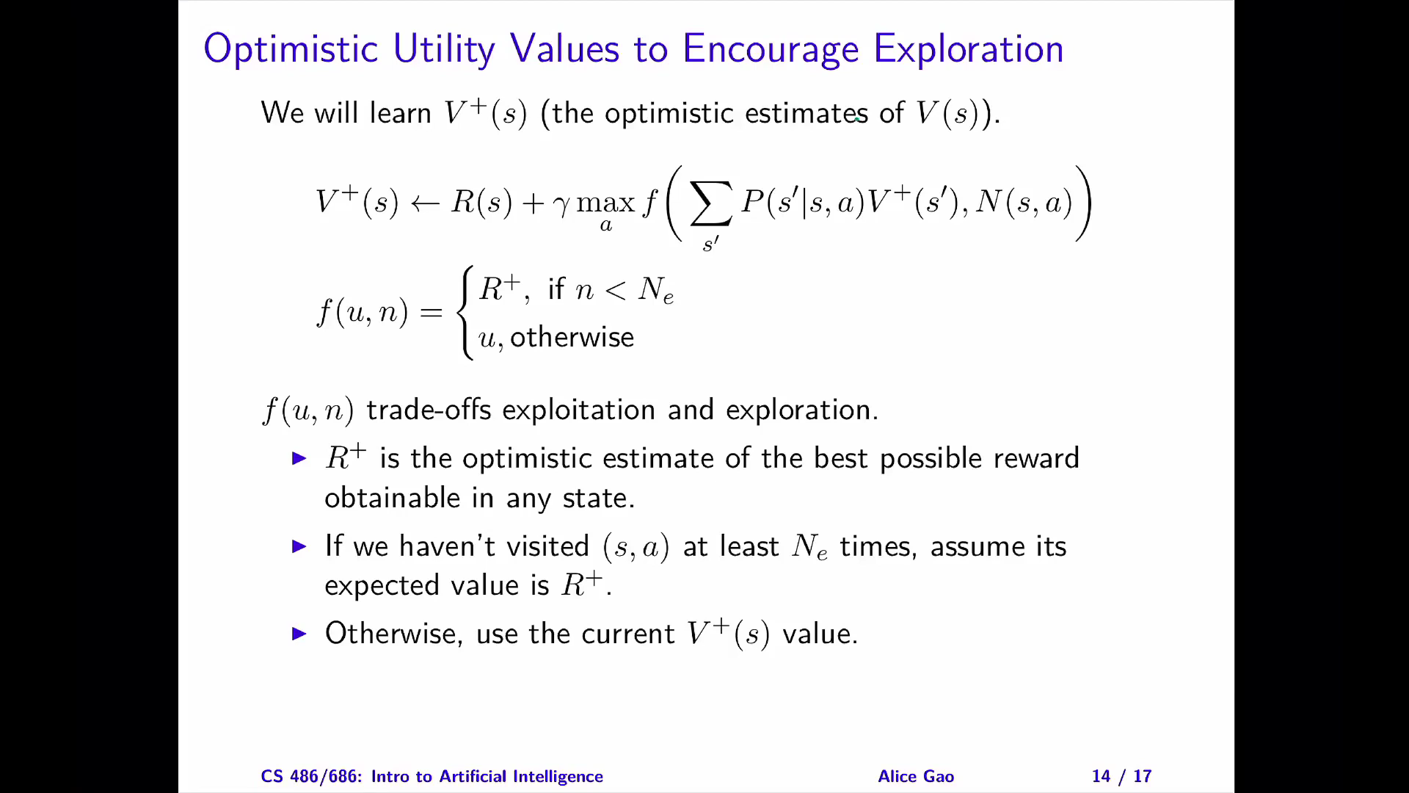

Slide 10
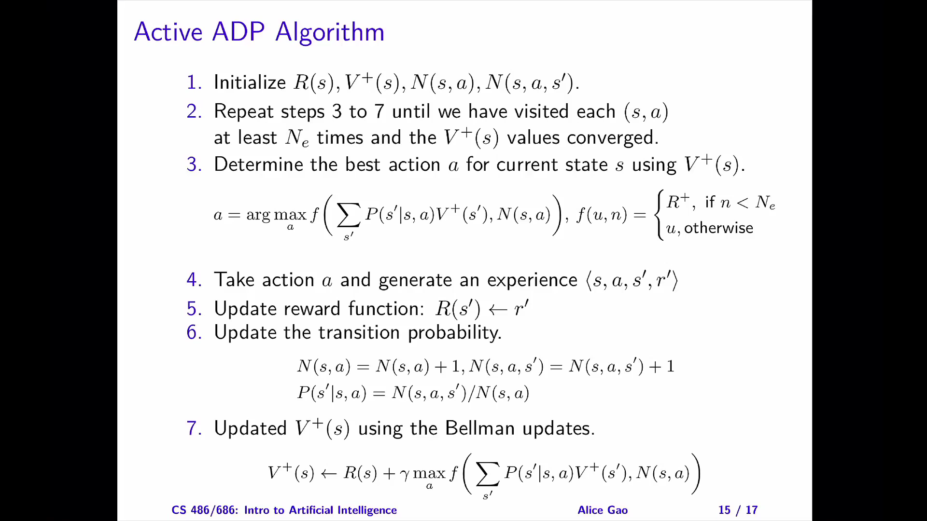

Slide 11
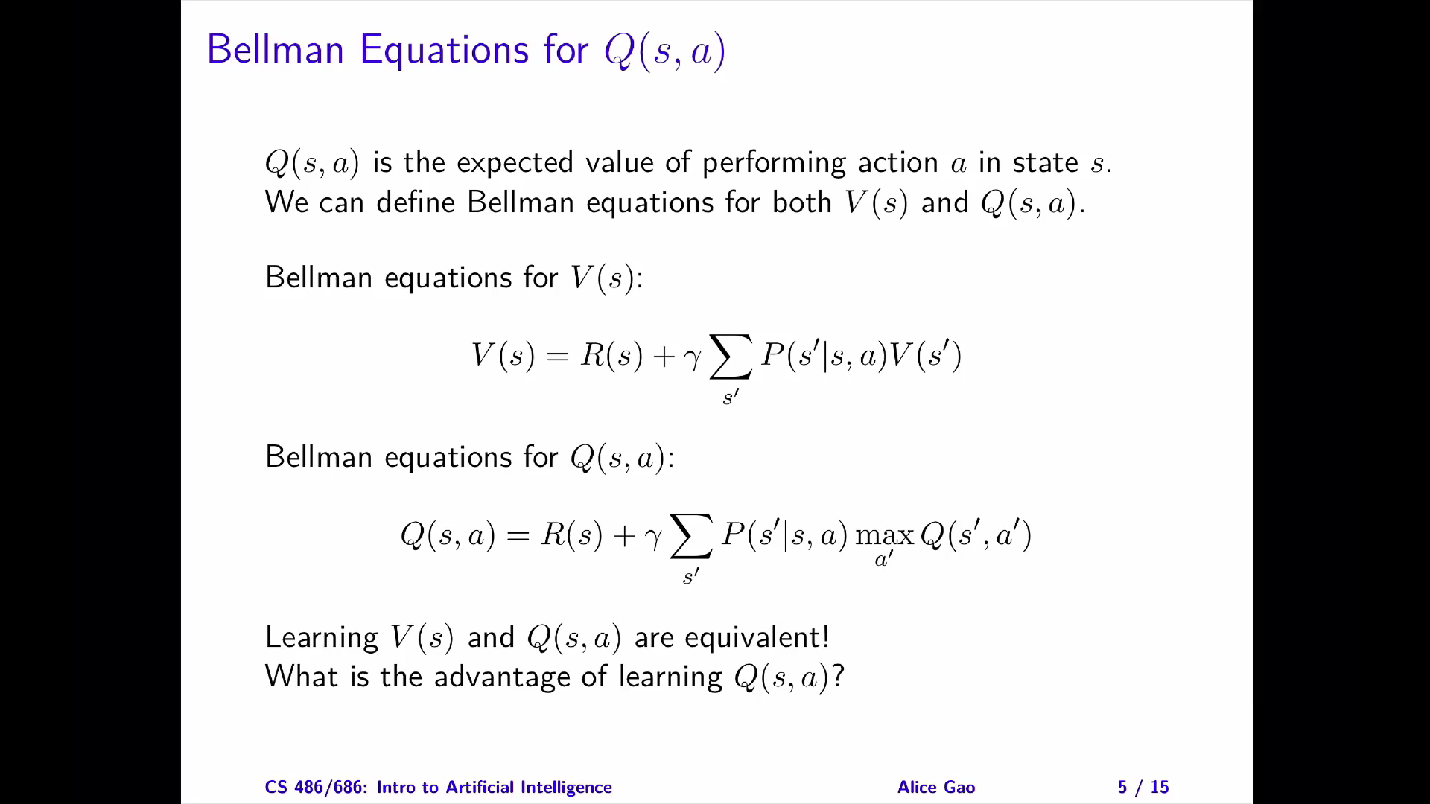

Slide 12
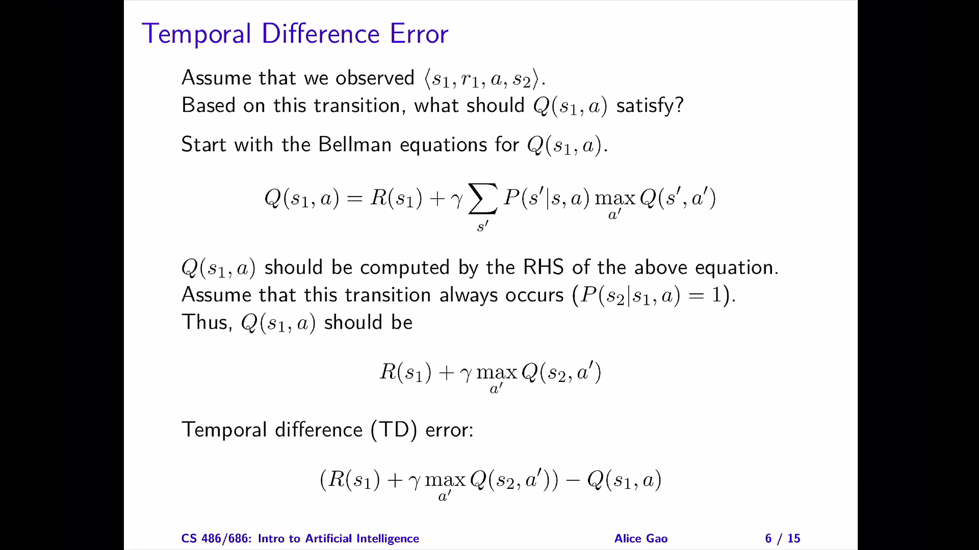

Slide 13
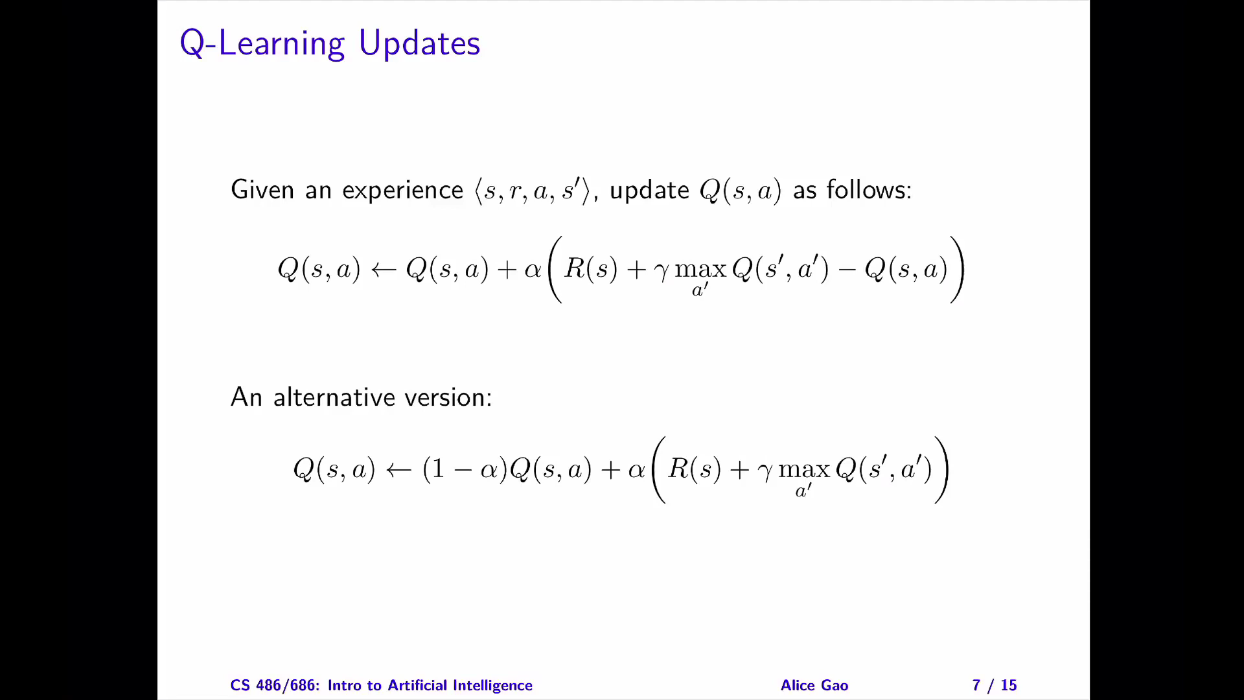

Slide 14
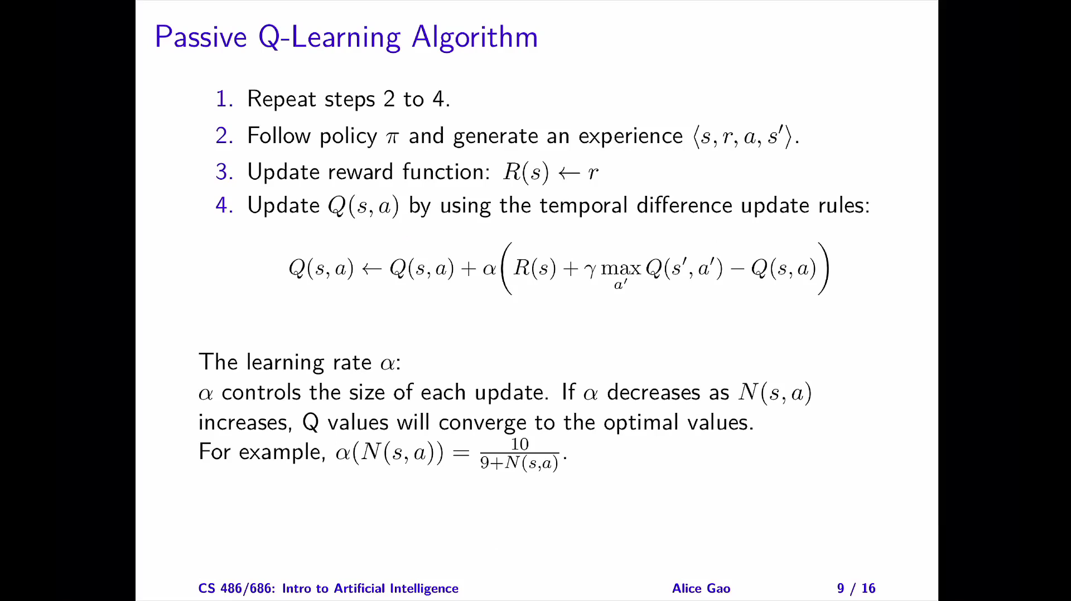

Slide 15
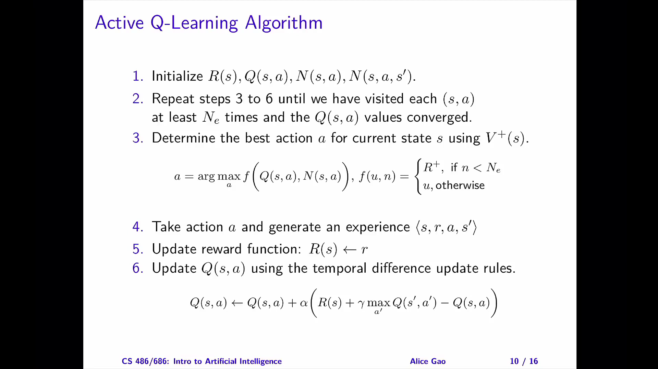

Slide 16
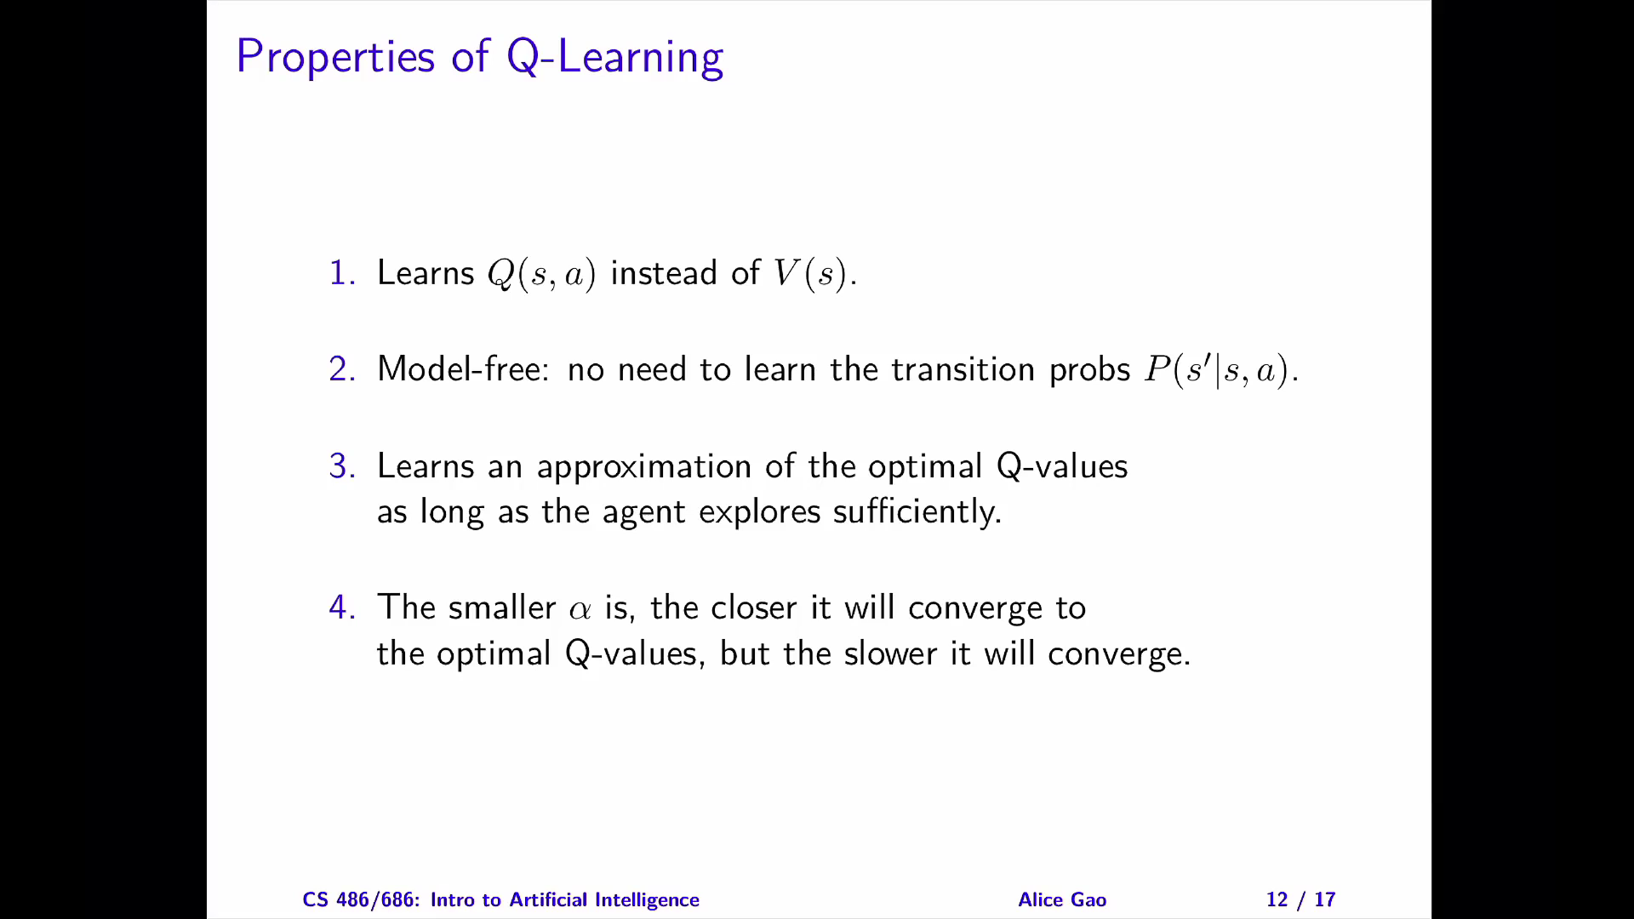

Slide 17
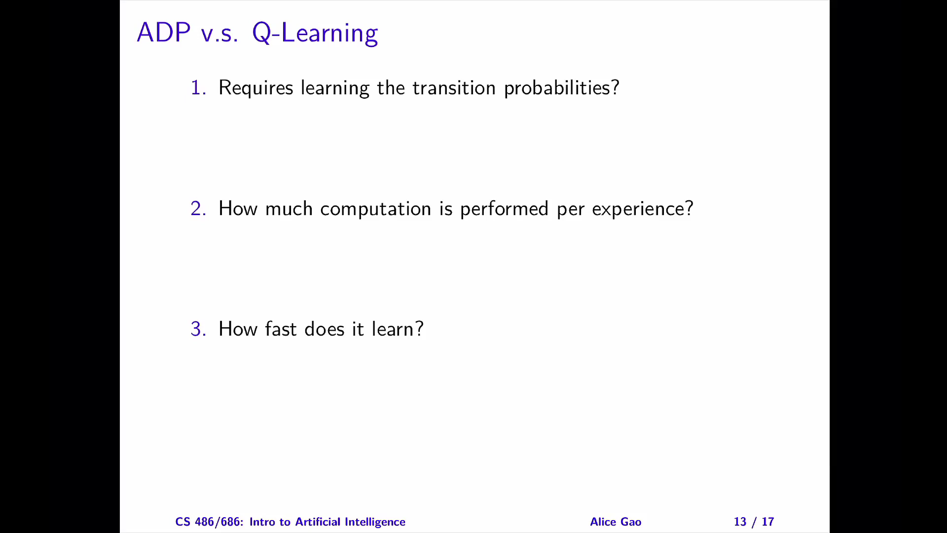

Slide 18


SARSA
Q-Learning
SARSA

Slide 19
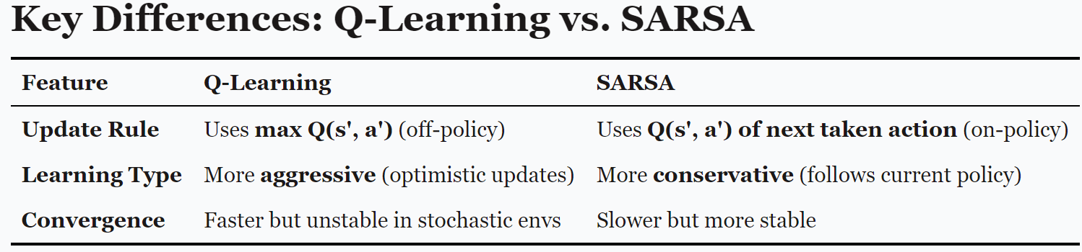
Conclusion
Q-Learning is more optimistic because it selects the max Q-value for future updates.
SARSA updates based on the next chosen action, leading to more conservative learning.

Slide 20
Thank You
Dr. Rajiv Misra, Professor
Dept. of Computer Science & Engg.
Indian Institute of Technology, Patna
rajivm@iitp.ac.in

